Slide 1


XSS attack detection
Supervised by : DR.Wael el Sersy
Student name: mohamed haitham

Slide 2

Agenda
Introduction
Methodology
Objectives
Related work
Conclusion
references

Slide 3
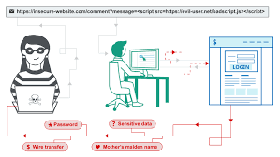


introduction
Cross-site scripting (XSS) is one of the most frequently occurring types of attacks on web applications.
XSS is where the attacker injects malicious code, typically JavaScript, into the web application in order to be executed in the user’s browser.
XSS can affect the victim in several ways some of these ways are: stealing cookies, modifying a web page, capturing clipboard contents, keylogging, port scanning, dynamic downloads, and other many attacks .

Slide 4
Problem statement
XSS allows attackers to inject malicious scripts (usually in the form of JavaScript) into web pages viewed by other users. When these malicious scripts execute in the context of a victim's browser, they can perform various harmful actions, including stealing user data, session cookies, or other sensitive information, defacing websites, redirecting users to malicious sites, and more.
The xss attacks that are stored can't be detected

Slide 5
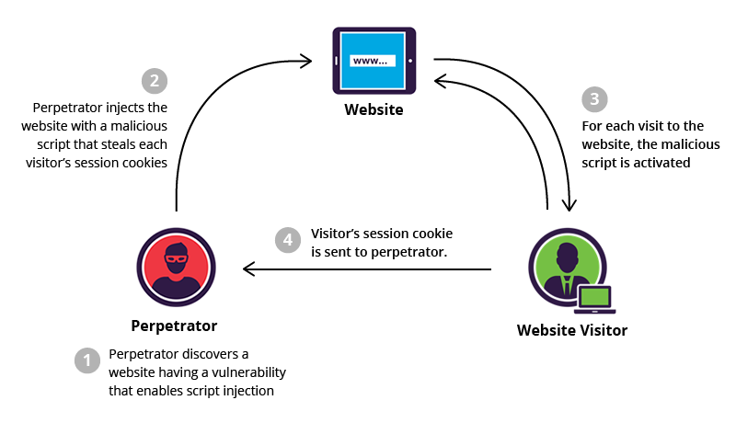

Slide 6

Motivation
The xss attacks could cause huge problems like: the XSS attack leads to a complete compromise of the victim's account.
The xss attack can also lead stealing data and authentication cookies.

Slide 7
objectives
Evaluate the previous work
Detecting the XSS attacks using the neural network classifier
Improve the performance
Detection of the stored XSS attacks
Creating model for detecting the xss attacks with higher performance ad higher accuracy
Evaluation of the model
Devoloping the system in the form of a website for user's inegration

Slide 8
Detecting Cross-Site Scripting Attacks Using Machine Learning. In Advanced Machine Learning Technologies and Applications.(2018)
Problem :this paper Is talking about the detection of the cross site scripting attacks(XSS)using machine learning
Datasets: there are two datasets were gathered, the first one is for training and the second one is for testing. The first (training) dataset contains 2000 of each of malicious and benign scripts, The second (test) dataset contains 13,000 each of malicious and benign scripts
Methodology: this paper detects and tries to limit the XSS attacks by investigating using the SVM, k-NN and Random Forests
Results : this paper has achieved that that SVM, k-NN, and Random Forest can be used to build classifiers for XSS coded in JavaScript giving high accuracy (up to 99.75%) and precision (up to 99.88%) when applied to a large real world data set.
Limitations : no limitatons.
Future work: is to investigate these aspects, as well as to use the same features with a Neural Network classifier.

Slide 9
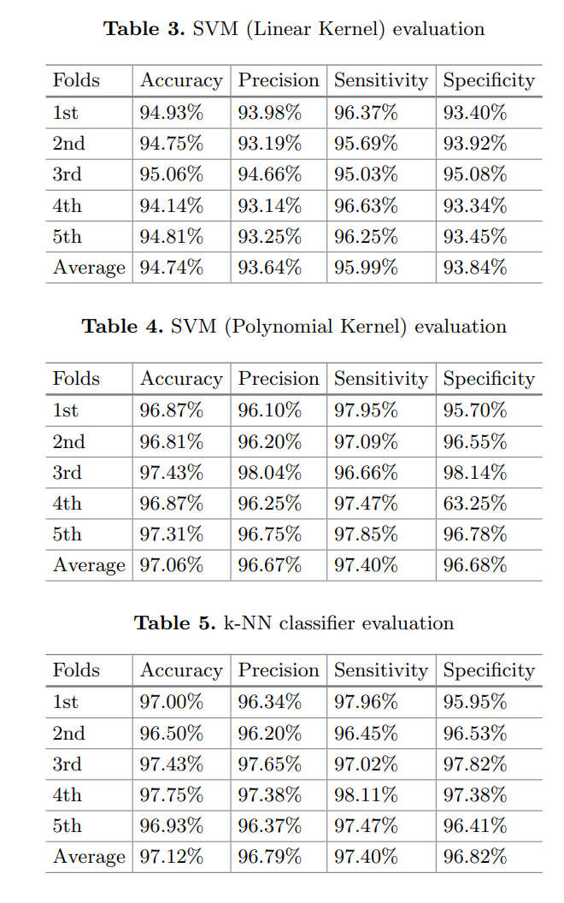
Results of First research paper

Slide 10
An Integrated XSS-Based Attack Detection Scheme in Web Applications Using Multilayer Perceptron Technique.(2019)
Problem statement : The paper explains the concept of Cross-Site Scripting (XSS) attacks, where attackers inject malicious scripts into web applications. It categorizes XSS into three types: reflected, stored, and DOM-based XSS. The paper explains the concept of Cross-Site Scripting (XSS) attacks, where attackers inject malicious scripts into web applications. It categorizes XSS into three types: reflected, stored, and DOM-based XSS.
Data sets: they collected about500.000 HTTPrequest/response pairs from 95 popular web applications, this dataset is collected from a highly profile websites.
Methodology: Malicious scripts were used in the evaluation, including a common credential-stealing attack.
These malicious scripts were injected in various ways, including as inline scripts, event handlers, and into existing scripts (directly behind string constants or appended at the end).
Results: The evaluation results showed that the generic XSS detector could reliably identify injected attacks and real-life examples, resulting in a false-negative rate of 0 for all tested web applications.
Approximately 80% of the web applications did not encounter any false positives, indicating that the detector worked effectively for these applications.
The remaining 20% of web applications caused varying numbers of false alarms, primarily due to non-trivial, dynamic code generation techniques not yet handled by the detector.
Limitations: Inability to Detect Stored XSS in Some Cases, Complexity and Performance, Limited Detection of External Script Inclusion.as the
Future work: Handling Content Other Than HTML, Browser-Specific Attack Vectors, Performance Optimization,Handling External Scripts.

Slide 11
XSSDS: server side detection of cross site scripting attacks(2008)
Problem statement: The problem statement presented in the provided paper is focused on the detection of Cross-Site Scripting (XSS) attacks in web applications. The paper outlines the importance of defending against such attacks, given the increasing use of web technology in various services, including web banking, chatbots, recommendation engines, and social networking sites, which have become integral to our daily lives.
Methodology: Collecting Raw Data, The next step is to extract features from the collected data that can effectively represent the presence of XSS attacks. An ANN-based detection scheme is proposed for identifying XSS-based attacks in web applications. Multilayer Perceptron (MLP), a type of neural network, is used for the detection task. The ANN is trained on the extracted features from the dataset.
Dataset: The final dataset consists of a total of 138,569 samples. Among these, there are 100,000 benign samples and 38,569 malicious samples. Each sample is represented by 41 features. asThe dataset includes both benign (non-malicious) and malicious samples.
Results : The model achieved an accuracy of 99.32% on the testing dataset. This metric measures the overall correctness of the model's predictions. The precision for the XSS class (malicious) was 99.21%. Precision measures the proportion of true positive predictions among all positive predictions, providing insight into the model's ability to make accurate positive classifications. The detection rate for the model was 98.35%. Detection rate, also known as recall ,while The false positive rate was very low, tending to zero, specifically 0.31%.
Limitations: no limitations
Future work :Real-Time Detection System: As stated in the text, one potential avenue for future work is to further develop and apply the proposed scheme for real-time detection of XSS attacks.

Slide 12
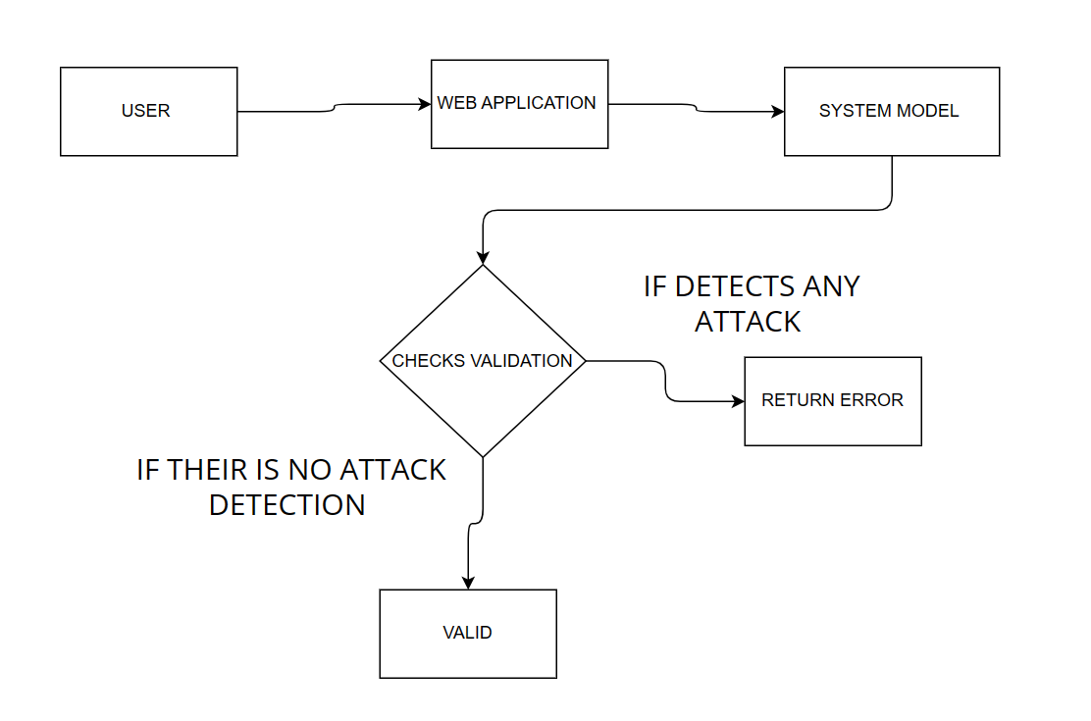
SYSTEM ARCHITECTURE

Slide 13
Proposed solution
In this project XSS attacks will be detected using machine learning
The aim is to get higher accuracy and higher performance and better time consuming in the detection of XSS attacks and this will be done using better methods, algorithms and bigger datasets.

Slide 14
references
Mokbal, F. M. M., Dan, W., Imran, A., Jiuchuan, L., Akhtar, F., & Xiaoxi, W. (2019). MLPXSS: an integrated XSS-based attack detection scheme in web applications using multilayer perceptron technique. IEEE Access, 7, 100567-100580.
Mereani, F. A., & Howe, J. M. (2018, January). Detecting cross-site scripting attacks using machine learning. In International conference on advanced machine learning technologies and applications (pp. 200-210). Cham: Springer International Publishing.
Johns, M., Engelmann, B., & Posegga, J. (2008, December). Xssds: Server-side detection of cross-site scripting attacks. In 2008 Annual Computer Security Applications Conference (ACSAC) (pp. 335-344). IEEE.

Slide 15
Thank you

